Slide 1
Explaining algorithms and automation: A guide for lawyers
Dr. Reuben Binns, Dept. Computer Science, University of Oxford
reuben.binns@cs.ox.ac.uk

Slide 2
Overview
Digitisation, automation, decision-making
Rule-based vs statistical systems Bias, error, discrimination Automation bias
Unequal and fettered discretion

Slide 3
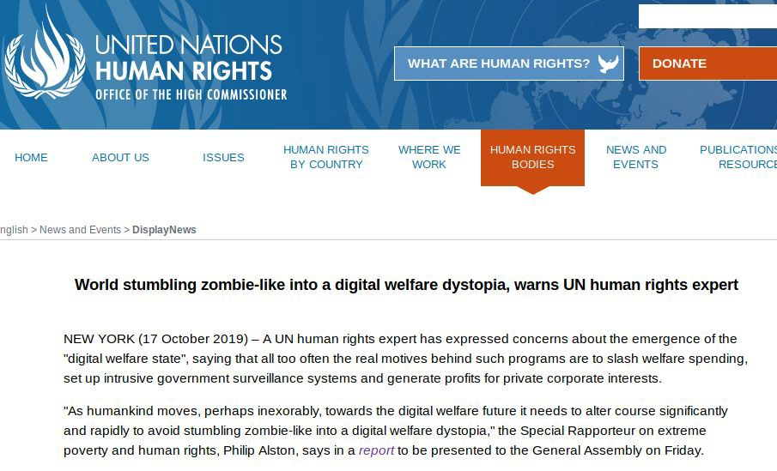
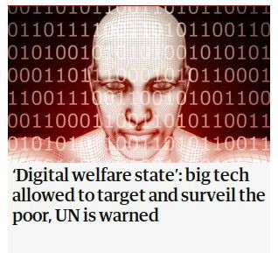
https://www.ohchr.org/EN/NewsEvents/Pages/DisplayNews.aspx?NewsID=25156&LangID=E
https://www.theguardian.com/technology/2019/oct/16/digital-welfare-state-big-tech-allowed-to-target-and-surveil-the-poor- un-warns

Slide 4
Digitisation, automation, decision-making
Digitisation of paper forms (e.g. tax returns online)
Automation of processes (e.g. automatically recurring payments) Computer-supported / automated decision-making (ADM), e.g.:
Determining eligibility for beneﬁt
Risk scoring based on statistical models Fraud detection

Slide 5
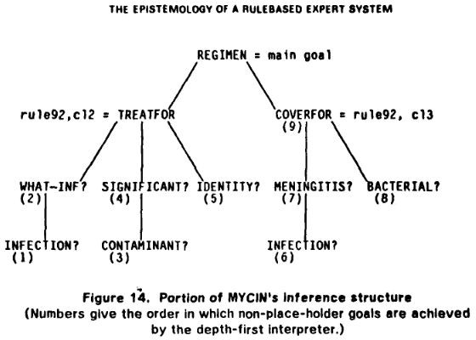
Rules-based systems
e.g.
IF “years_in_residence” > 5: THEN:
“settled_status_eligibility” = TRUE
Clancey, William J. "The epistemology of a rule-based expert system—a framework for explanation." Artificial intelligence 20.3 (1983): 215-251.

Slide 6
Statistical systems
Aim to classify, predict, or score
How similar is this beneﬁts application to previously fraudulent ones?
How likely is this person to re-oﬀend (based on statistics from previous cases?) How risky is the person behind this visa application?

Slide 7
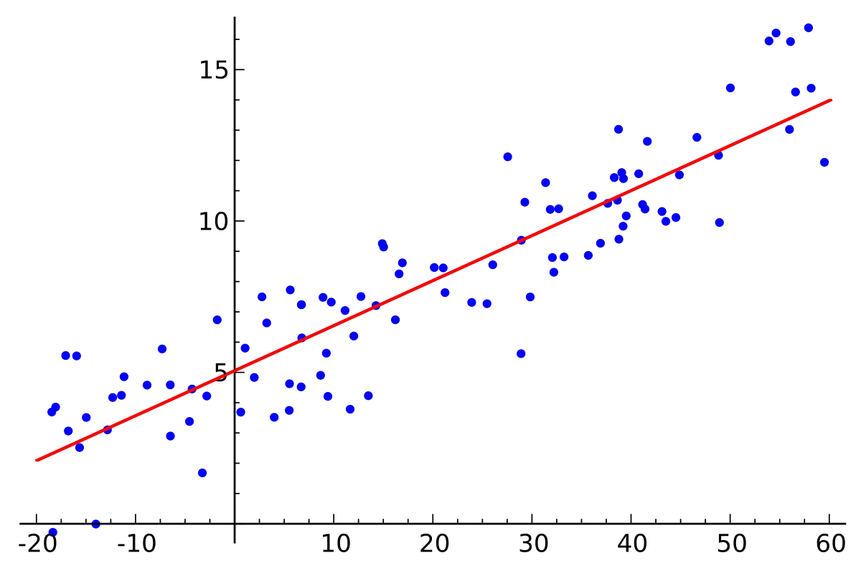
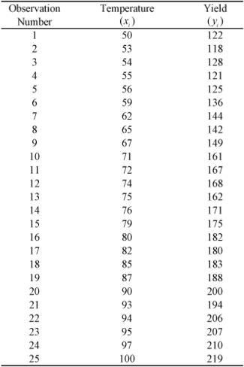



Default
Salary
P(default)
Salary
Learning Algorithm
Data
Model

Slide 8
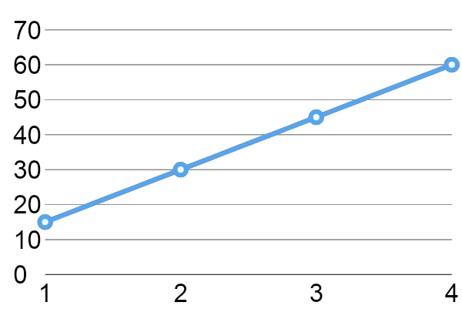
Applicant
P(default)
->
Threshold
P(default)
Salary
Salary
If P(default) > threshold, then deny credit

Slide 9
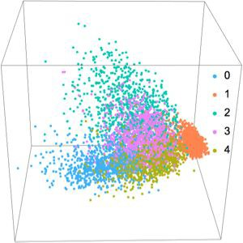
High-dimensionality

Slide 10
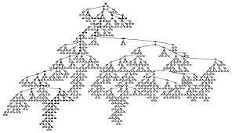
Complexity

Slide 11
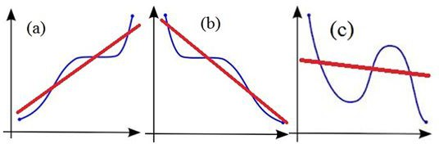
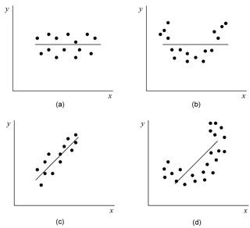
Non-linear
Non-monotonic

Slide 12
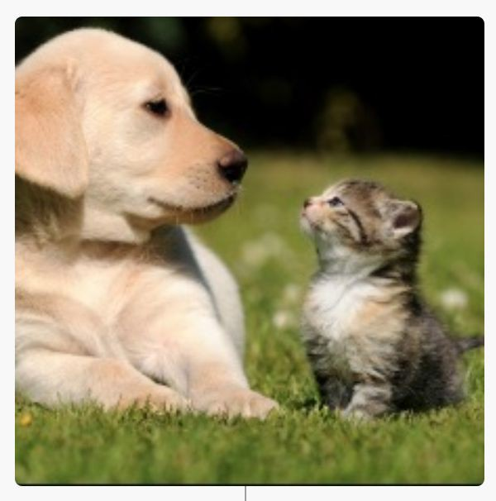
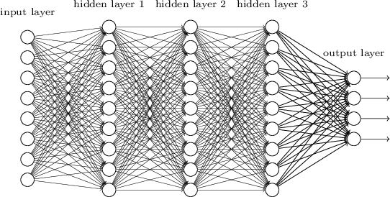
‘Deep learning’
…labrador?
features: { 1,1 = black, 1,2 = brown, 1,3 = grey …}
hidden layers: {?}

Slide 13
Bias, error, discrimination in statistical models
False positives vs false negatives
Fitting to the majority population
Reﬂecting (and compounding) structural discrimination

Slide 14
Bias, error, discrimination in statistical models
- False positives vs false negatives
Fitting to the majority population
Reﬂecting (and compounding) structural discrimination

Slide 15
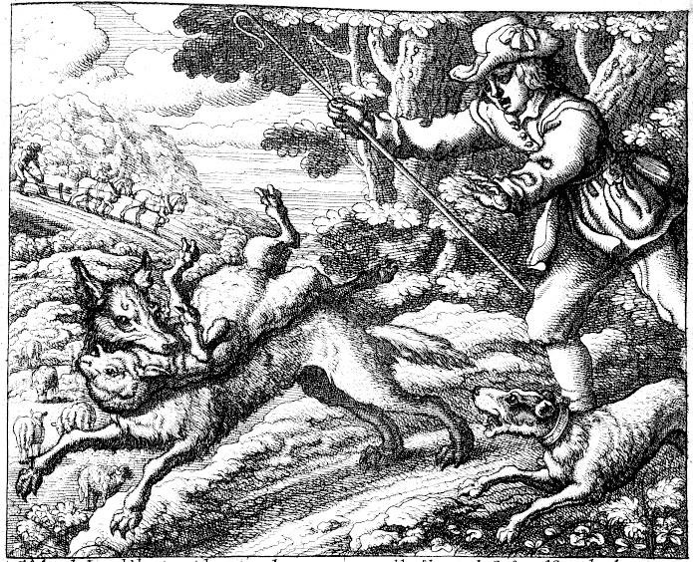
False Positive:
the boy cried wolf... but no wolf
False Negative:
The villagers thought ‘no wolf’
… but wolf!

Slide 16
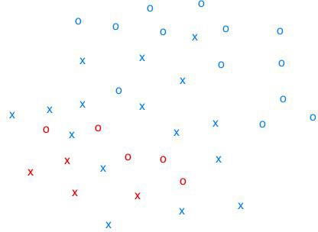
x = reoﬀend
o = not reoﬀend

Slide 17
x = reoﬀend
o = not reoﬀend

Slide 18
x = reoﬀend
o = not reoﬀend
False positive rate = 3/14 = 21%
False negative rate = 6/24 = 25%

Slide 19
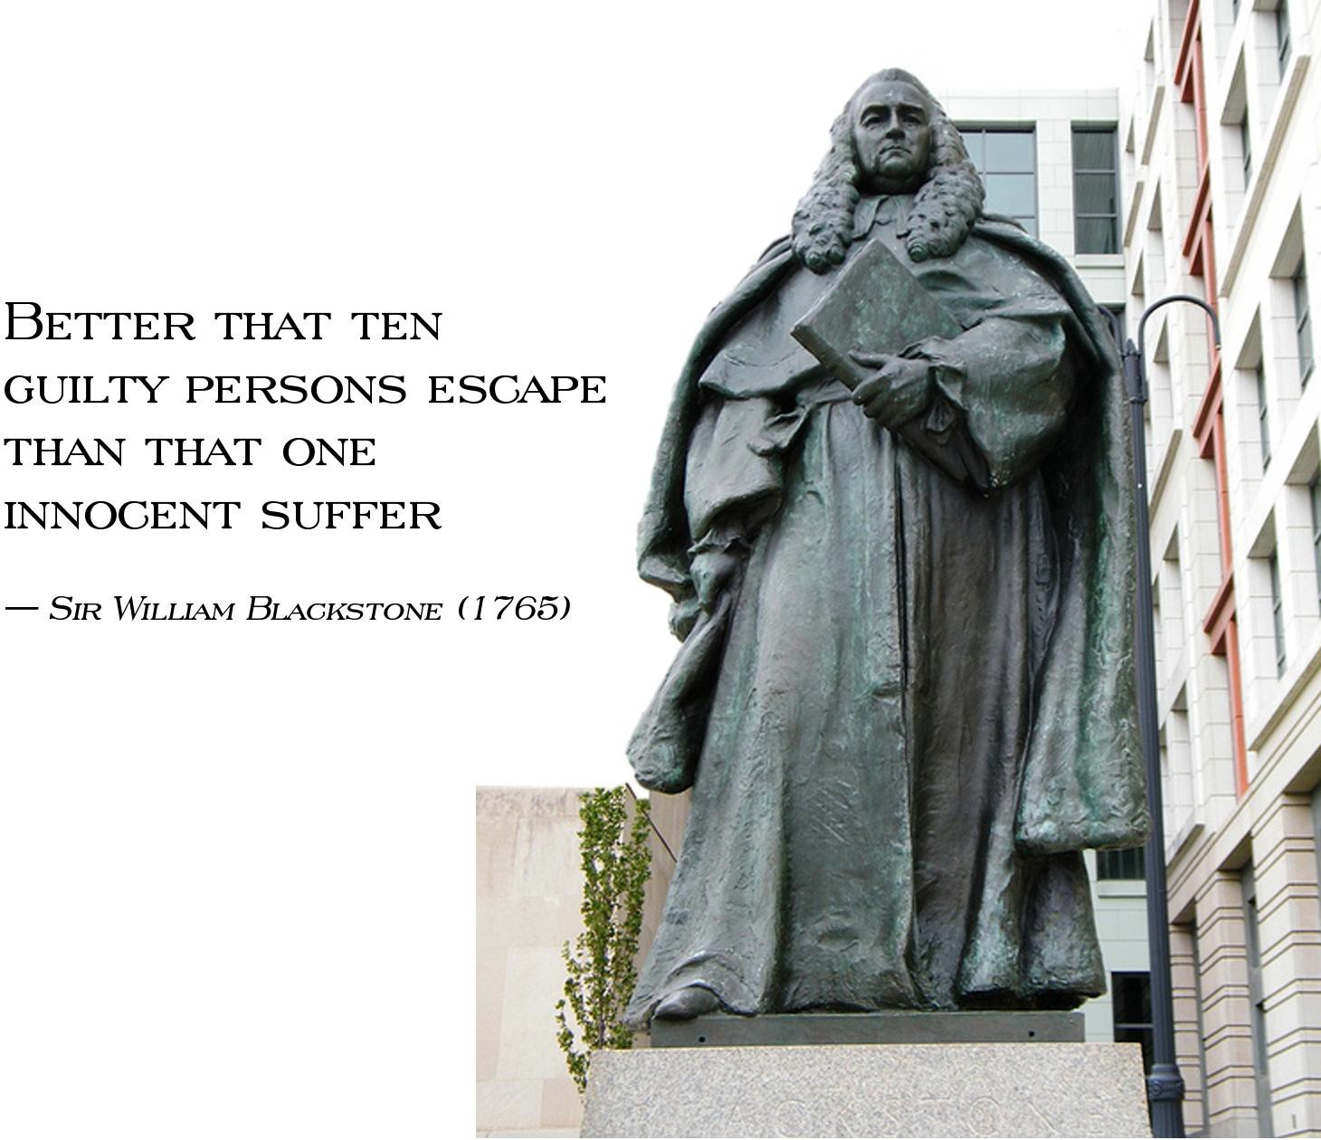
Sir William Blackstone by Paul Wayland Bartlett - Washington, D.C.

Slide 20
Bias, error, discrimination in statistical models
- False positives vs false negatives
- Fitting to the majority population
- Reﬂecting (and compounding) structural discrimination

Slide 21
x = reoﬀend
o = not reoﬀend

Slide 22
x = reoﬀend
o = not reoﬀend

Slide 23
Bias, error, discrimination in statistical models
False positives vs false negatives
Fitting to the majority population
- Reﬂecting (and compounding) structural discrimination

Slide 24
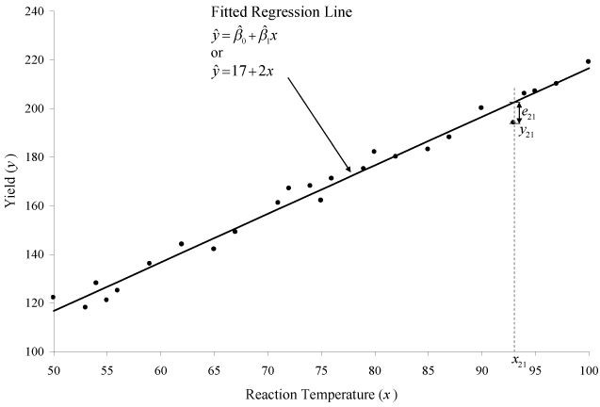




prior oﬀence
Model
re-oﬀend

Slide 25
prior arrests
Model
re-arrest

Slide 26
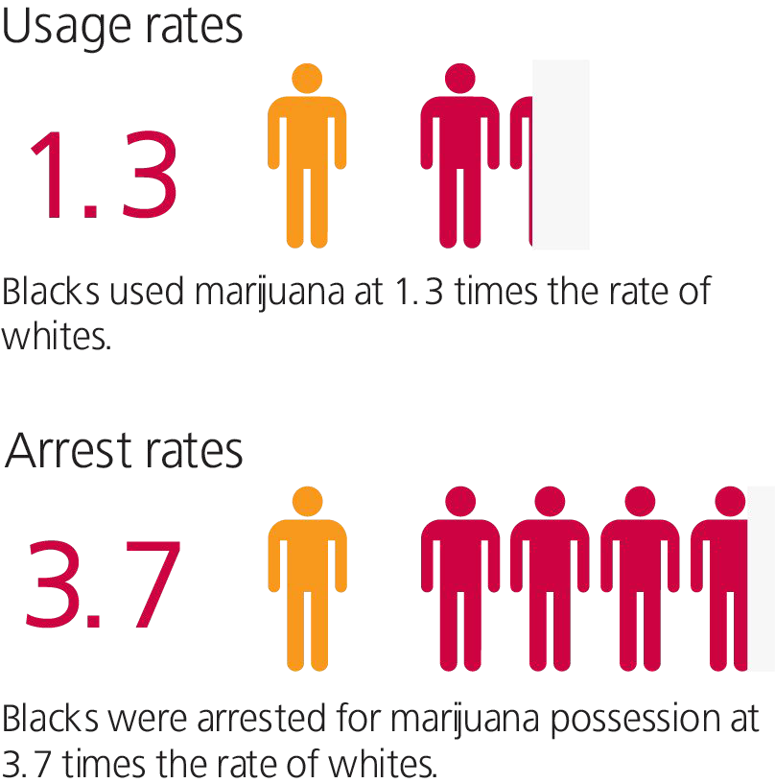
prior arrests
Model
re-arrest
Report: The War on Marijuana in Black and White, ACLU
https://www.aclu.org/report/report-war-marijuana-black-and-white?redirect=criminal-law-reform/war-marijuana-black-and-white

Slide 27
prior arrests
Model
re-arrest
Report: The War on Marijuana in Black and White, ACLU
https://www.aclu.org/report/report-war-marijuana-black-and-white?redirect=criminal-law-reform/war-marijuana-black-and-white

Slide 28

“black people are now nine times more likely to be stopped and searched for drugs despite using drugs at a lower rate than white people”
https://www.release.org.uk/publications/ColourOfInjustice

Slide 29
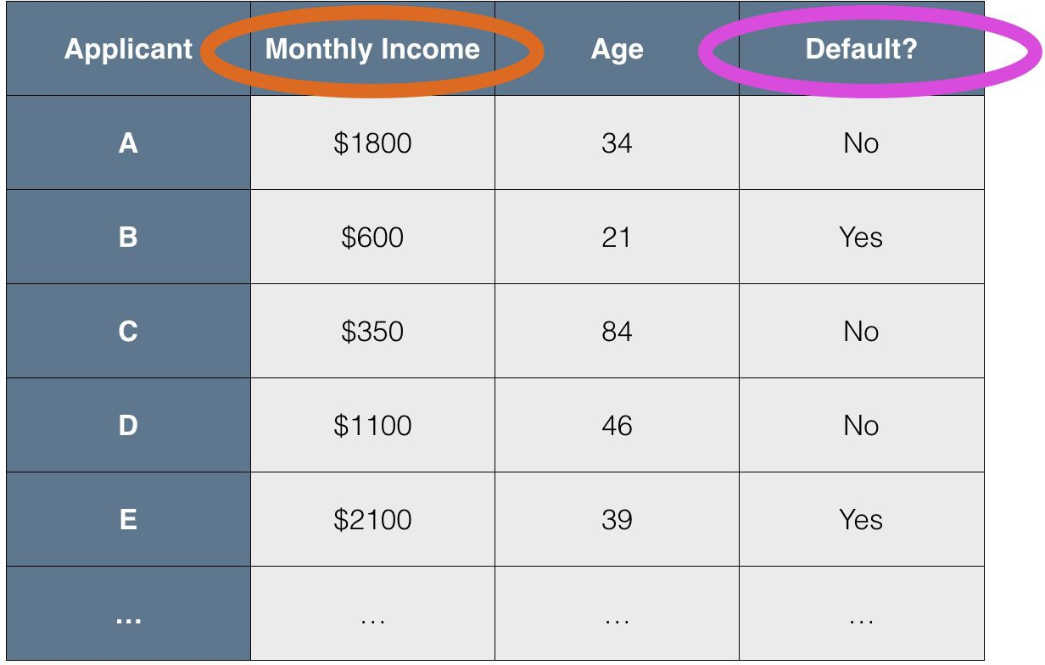
high risk medium risk low risk
no risk
features: { qualiﬁcations, postcode, place of birth, occupation, behavioural data, …}
latent features: {?}
{ ~gender?, ~ethnicity? }

Slide 30
Parity of errors between protected classes
protected groups receive equal proportion of errors
Model performance on male applicants
Model performance on female applicants

Slide 31
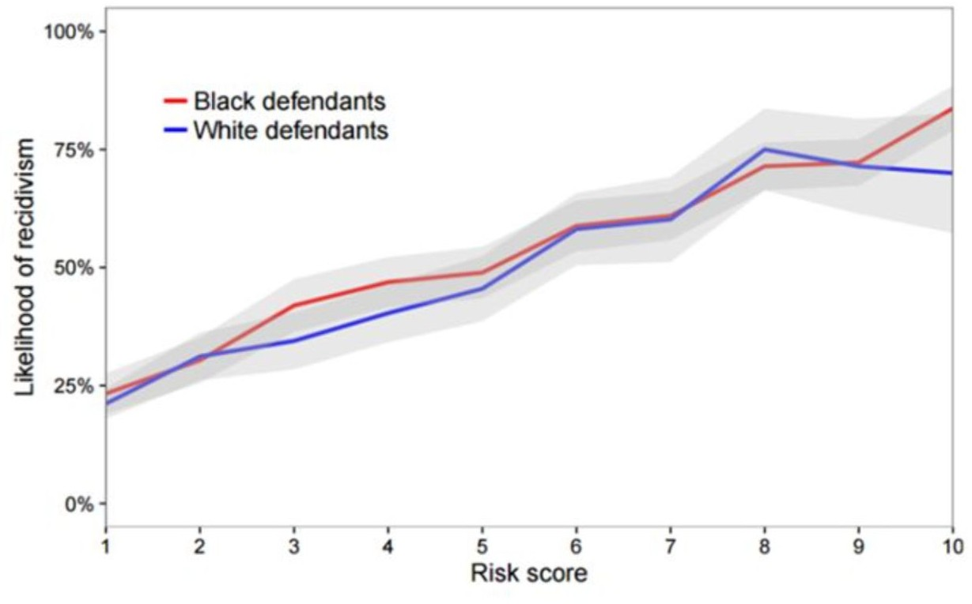
Parity of calibration between protected classes
Calibration: of those given a particular risk score S, S% should result in the predicted outcome.
Calibration should be equal between protected groups
Image from “Deﬁning and Designing Fair Algorithms"
Sam Corbett-Davies and Sharad Goel Stanford University. EC18 Fairness tutorial

Slide 32
Roles for automated decision-making
Decision support vs full automation
Decision support: providing additional information, informed by statistical or rules-based systems, to aid a human decision-maker in their decision.
  E.g. a risk score presented to a parole oﬃcer to inform their assessment of an oﬀender
Fully automated: the system takes a decision and action in relation to a person or group without human input.
  E.g. a visa application is automatically assessed and approved
NB: implications for data protection (GDPR Article 22 ‘solely automated’ decisions)

Slide 33
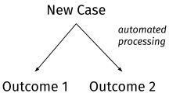
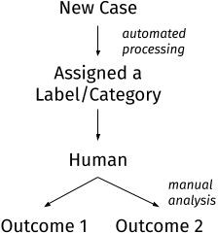
Decision support
Fully automated

Slide 34
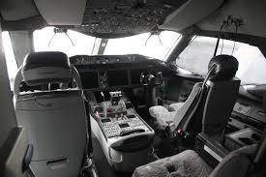
Automation bias
Human decision-makers may either systematically:
Under-rely on computer outputs, ignoring good information
Over-rely on computer outputs, ignoring their own judgement and supplemental information from other sources
Daniel Schwen / Wikimedia Ccmmons. Boeing 787 cockpit at the Museum of Flight near Seattle

Slide 35
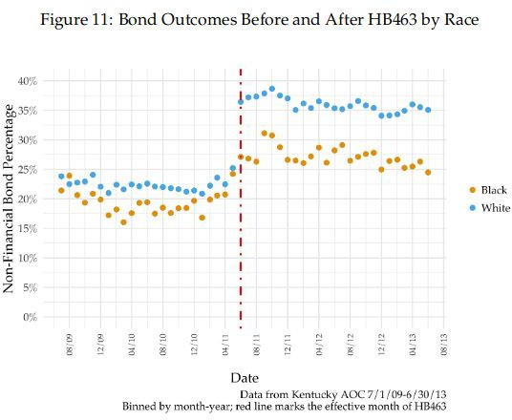
Unequal application of discretion
Under-reliance and over-reliance might be applied unequally between diﬀerent groups.
Even if the algorithm is not biased, the way that human decision-makers use it may interact with existing prejudice / bias
See introduction of COMPAS in US (Albright (2019), Cowgill (2019))
Alex Albright. 2019. If You Give a Judge a Risk Score: Evidence from Kentucky Bail Decisions.The John M. Olin Centerfor Law, Economics, and Business Fellows’ Discussion Paper Series85 (2019).

Slide 36

Unequal application of discretion
An initial ADM stage may determine which
human decision makers make the assessment
Even if no decision is taken without a human, the algorithmic step determines the type and quality of human judgement
Independent Chief Inspector of Borders and Immigration, ‘An inspection of entry clearance processing operations in Croydon and Istanbul’ https://assets.publishing.service.gov.uk/government/uploads/system/uplo ads/attachment_data/ﬁle/631520/An-inspection-of-entry-clearance-proces sing-operations-in-Croydon-and-Istanbul1.pdf

Slide 37
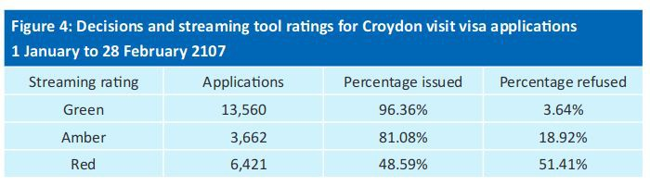
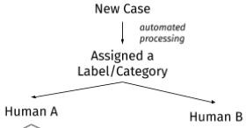
Unequal application of discretion

Slide 38
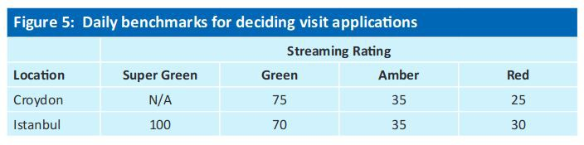
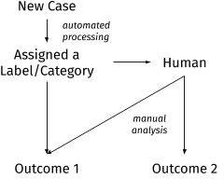
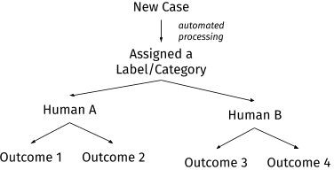
Upstream automation may fetter downstream discretion

Slide 39
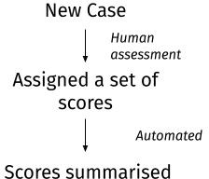
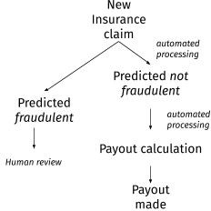
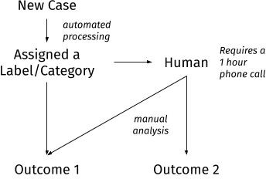
Where is the decision? Who / what made it?

Slide 40
Thanks!
Reuben Binns
reuben.binns@cs.ox.ac.uk Twitter: @RDBinns

