Slide 1
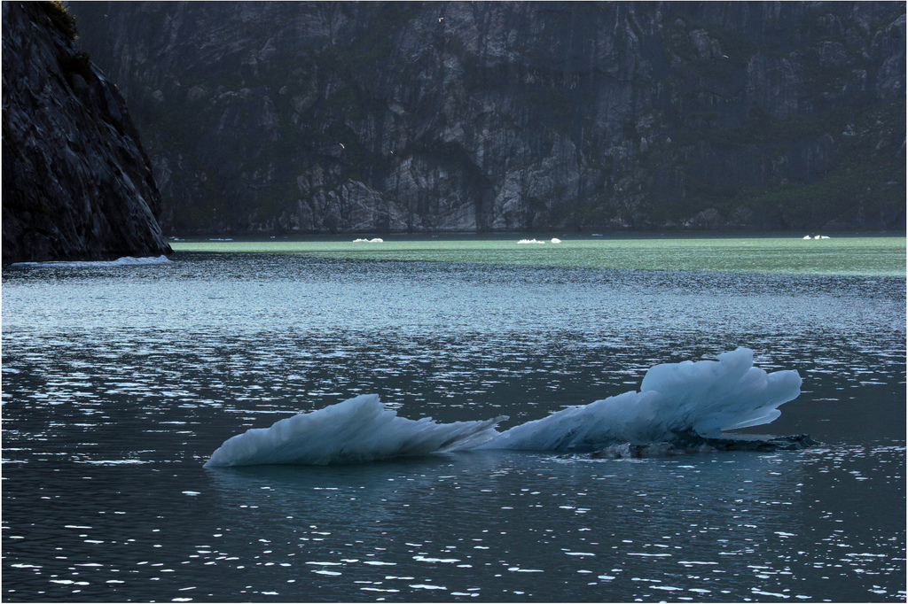
Environmental Costs Protection Regime – an introduction
PLP Costs in Judicial Review Speaker - Gillian Lobo
19 March 2020

Slide 2
An introduction to ClientEarth
ClientEarth is a non-profit environmental law organisation
We use law, science and policy to create pragmatic solutions to key environmental challenges
We work with partners in government and NGOs, providing legal solutions for policymakers and holding those in power accountable
Our work covers climate change and energy, environmental justice, biodiversity, forests and health and environment

Slide 3
The UNECE Aarhus Convention
Convention on Access to Information, Public Participation in Decision-making and Access to Justice in Environmental Matters was signed on 25 June 1998 in the Danish city of Aarhus (Aarhus Convention)
It entered into force on 30 October 2001
The EU and UK both ratiﬁed the Aarhus Convention in February 2005 and became parties in May 2005

Slide 4
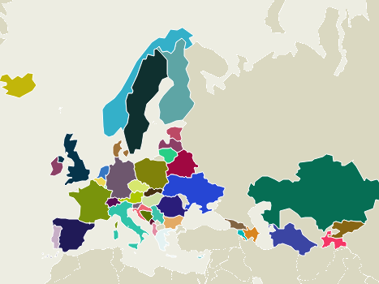
Parties to the Aarhus Convention
Source: UNECE (link)

Slide 5
UNECE Aarhus Convention
AARHUS CONVENTION
INFORMATION
PARTICIPATION
JUSTICE
DEMOCRACY/RULE OF LAW
Notes:
• Art. 9(1) – access to review procedure for any person whose request for environmental information has been ignored, refused or inadequately answered
• Art. 9(2) – access to review procedure for members of the public concerned to challenge substantive or procedural legality of decisions, acts or omissions subject to public participation provisions of art. 6
• Art. 9(3) – access to administrative or judicial procedures for members of the public to challenge other acts or omissions which contravene provisions of national law relating to the environment
• Art. 9(4) – these procedures shall provide adequate and effective remedies, and be fair, equitable, timely and not prohibitively expensive.

Slide 6
Access to justice in environmental matters
Article 9(3) of the Aarhus Convention: “each Party shall ensure that, where they meet the criteria, if any, laid down in its national law, members of the public have access to administrative or judicial procedures to challenge acts and omissions by private persons and public authorities which contravene provisions of its national law relating to the environment”
No direct effect in domestic law – but does have direct effect via the EC Public Participation Directive (Industrial Emissions Directive (2010/75/EU) and the Environmental Impact Assessment Directive (2011/92/EU))

Slide 7
CPR VII - Costs Limits in Aarhus Convention Claims – who can apply?
CPR 45.41 applies to a claim brought by a member of the public that falls within Article 9(1), 9(2) or 9(3) of the Aarhus Convention for:
judicial review; or
statutory review made under section s289 of the Town and Country Planning Act 1990 and s65 of the Town and Country Planning (Listed Buildings and Conservation Areas) Act 1990
Notes:
Does not cover private law claims

Slide 8
CPR VII - Costs Limits in Aarhus Convention Claims - how do you apply?
CPR 45.42 requires a claimant:
to tick the box in the claim form; and
file a schedule:
- of their financial circumstances i.e. their significant assets, liabilities, income and expenditure;
- include details of the aggregate financial support provided or likely to be provided by another person; and
- verify the schedule by a statement of truth
Notes:
Can secede not to come under the regime.

Slide 9
CPR VII -– how much?
CPR 45.43 introduces default caps:
(a) £5,000 for an individual;
(b) £10,000 for all other claimants; and
(b) £35,000 for the defendant
Limits apply to each claimant and defendant
Notes:
Multiple claimants and defendants – discretion of the court

Slide 10
CPR VII – how do you vary the cap?
CPR 45.44 allows the court to increase or decrease the default caps, but only if the variation will not be prohibitively expensive for the claimant
Costs will be prohibitively expensive if they :
exceed the financial resources of the claimant (subjective test) ; or
are objectively unreasonable by reference to specified criteria (objective test)
Notes:
Only have to meet one test
For financial /objective test need to take into account support from a third party

Slide 11
CPR VII – variation (2)
The objective criteria:
the situation of the parties;
whether the claim has a reasonable prospect of success;
the importance of what is at stake for the claimant;
the importance of what is at stake for the environment;
the complexity of the relevant law and procedure; and
whether the claim is frivolous

Slide 12
CPR VII – variation (3)
An application to vary the cap must be made by the claimant in the claim form and by the defendant in the acknowledgment of service
The matter must be determined by the court at the earliest opportunity
Later applications may be made if the claimant’s financial position significantly changes or the existing cap has been set on false or misleading information

Slide 13
Civil Liability
What more is needed?
...

Slide 14
Concerns
Caps of £5,000 for individuals and £10,000 for other claimants often exceed their financial resources but an application to vary may be uncertain and expensive
A cap of just £35,000 for the defendant means that successful claimants are generally out of pocket
Applications for variations are more likely to result in an increase in the claimant’s cap
Notes:
Aarhus – costs must be fair for the claimant. Cross cap for public policy reasons not Aarhus. Caps set in 2011

Slide 15
Concerns (2)
Separate costs caps for multiple claimants is unfair
Need to renew the application for a cap on appeal
Chilling effect of a potential open court hearing to vary a cap – likely to deter claimants and funders

Slide 16
Questions?

Slide 17
Thank you!
globo@clientearth.org

